Slide 1

Presented By:
Naimur Rahman Shomapto
Mahmudul Bari Saffat
Rafi Islam
Sanjana Akter Sanju
Presented To: MAHCY

Slide 2

Hospital Management System:
We wrote a c code to manage hospital as an admin. Here, an admin can add, update and delete patients. Moreover, he can add doctors and search for patients and doctors.
An admin, can also generate a report for the patients.

Slide 3
Functionalities of our code:
Add Patients
Display Patient Details
Update Doctor Status
Docter Report
Discharge Patient
Billing System

Slide 4
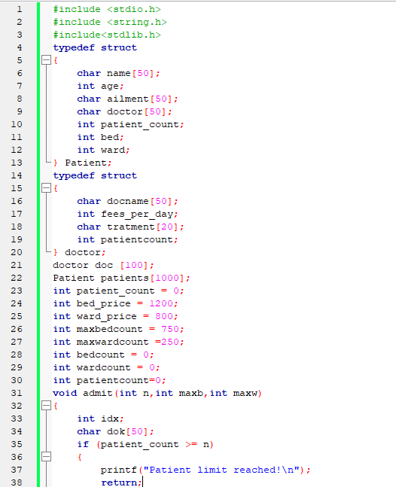
Starting.............................................
Define structures and declaring global values:
Structure to store information about patients
Structure to store information about doctors
To store the maximum number of beds and wards
Added global arrays and counters for patients and doctors.
declared the base patient count and doctor count

Slide 5
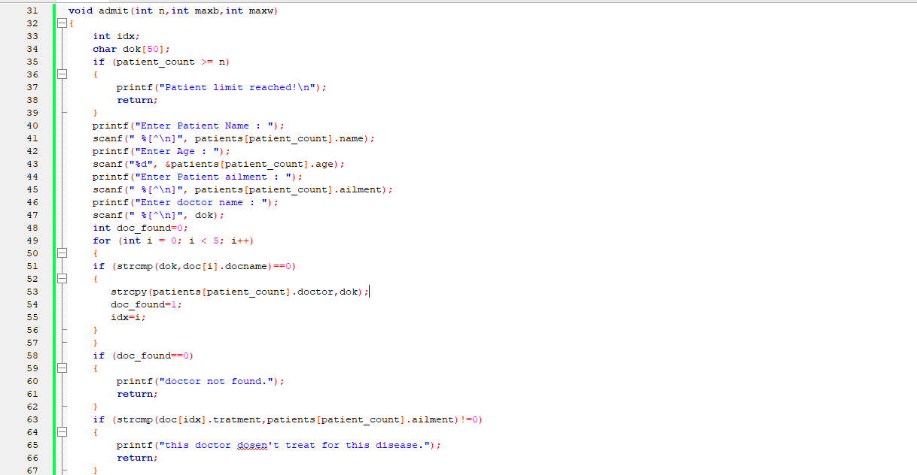
Admitting patient:
created a custom function to admit patients
the parameter n is the maximum number of patients.
checking if the maximum number of patients crossed
taking input from the user
adding the doc_found as 0 because it’s used for
how many doctor can join the hospital

Slide 6
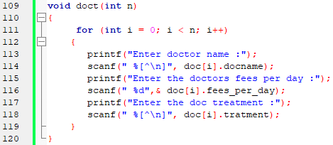
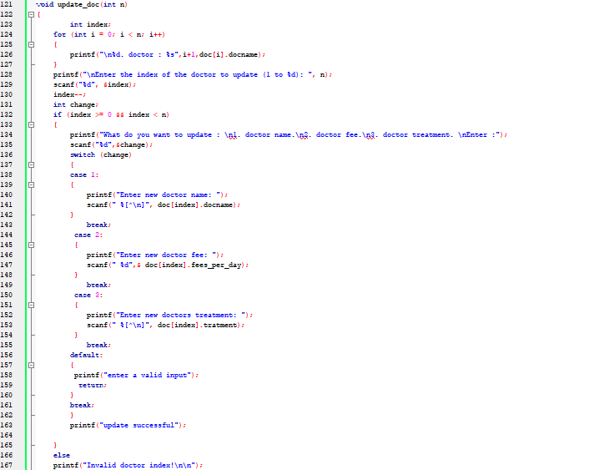
Checking doctor info:
this line declares a function named
doct and takes integer n
this loop iterates n time,where i is the loop counter
Updating Doctor Info:
this line declares a function named
update_doc and takes integer n
Index Validation
1.Update Doctor Name
2.Update Doctor Fees
3.Update Doctor Treatment

Slide 7
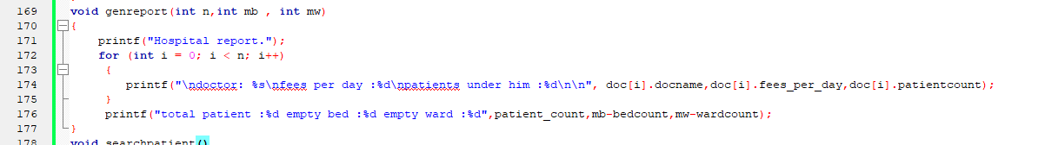
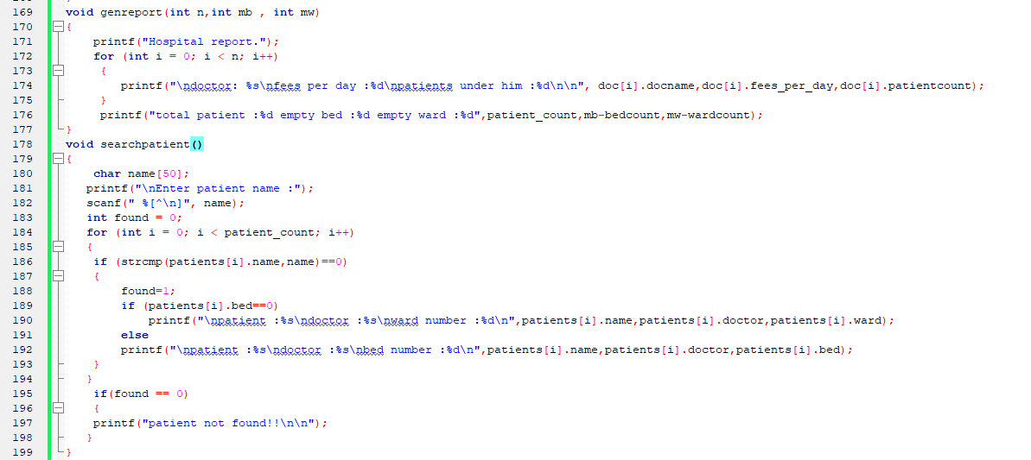
Generating Report:
This declares a function named genreport
that take three integer arguments
this loop iterates n time,where i is the loop counter
Printing doctor information and
printing summary information
Searching Patient:
This declares a function named searchpatients
1.Int found=0; this line initialize a variable found to 0.
This variable will be used to keep track of whether the
patients was found or not.
2.This loop iterates through the array of patients.
3.If the match is found,the found variable is set to 1.
4.Else if the patient is found not in a ward,the
doctor name,patients name,bed no. is printed.

Slide 8
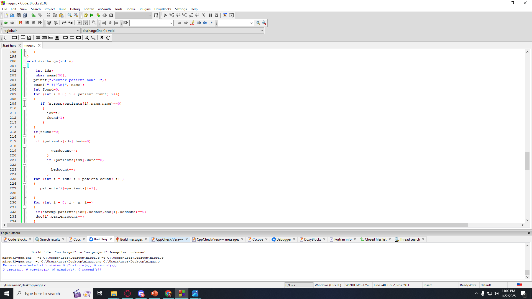
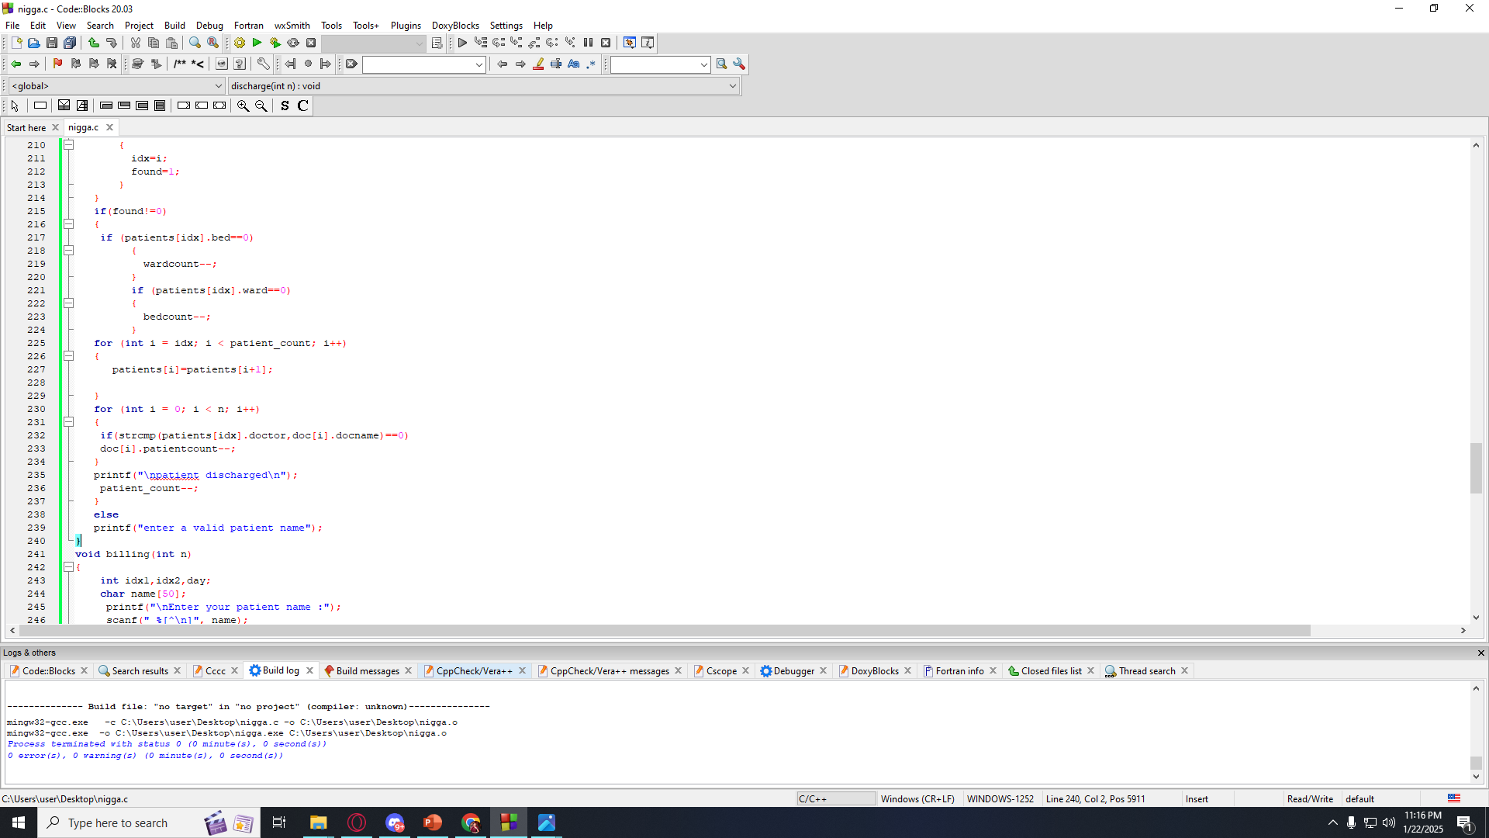
Discharging Patients:
This declares a function named discharge
1.Int found=0; this line initialize a variable found to 0.
This variable will be used to keep track of whether the
patients was found or not.
2.This loop iterates through the array of patients.
3.If the match is found, the found variable is set to 1.
4.Index number set as idx.
5.If we found the patient then we check if the patient is on bed or ward.
6.If the patient is found in bed then bedcount--
7.If the patient is found in ward then wardcount--
1.Initialization of this loop is the index number of the patient
2.We are storing the next patient’s info in the previous
index from the designated patient index.
3.In the next for loop we are checking patient’s appointed doctor
and after finding the doctor we are reducing the
patient count under the designated doctor.
4.Reducing the patient count.
If the patient is not found, then we print enter a valid patient name

Slide 9
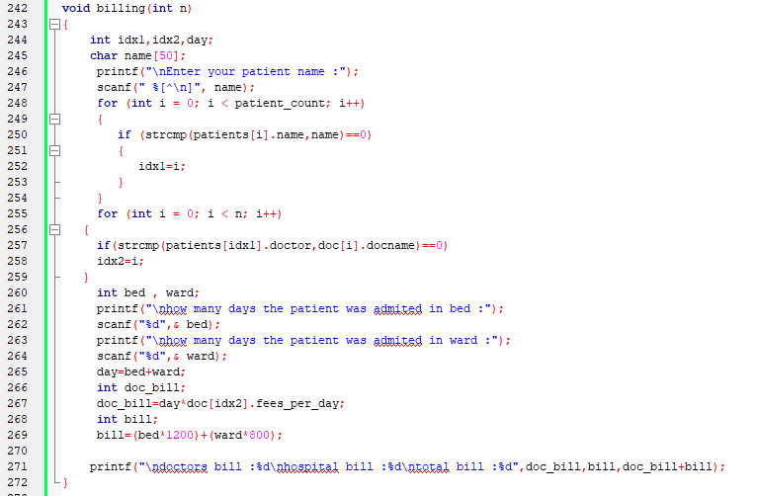
Billing System:
1.First line declares a function named
billing and takes integer n as argument,
2.Then takes input.
3.Patient index search and doctor index
search which iterates in the loops.
4.Input for bed and ward days.
5.Then bill calculation
6.Printing bills.

Slide 10
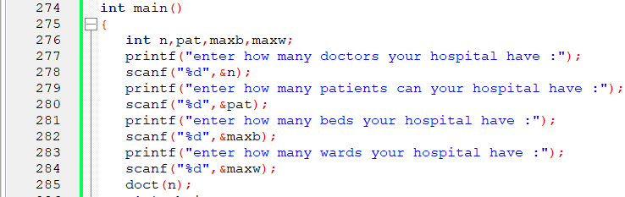
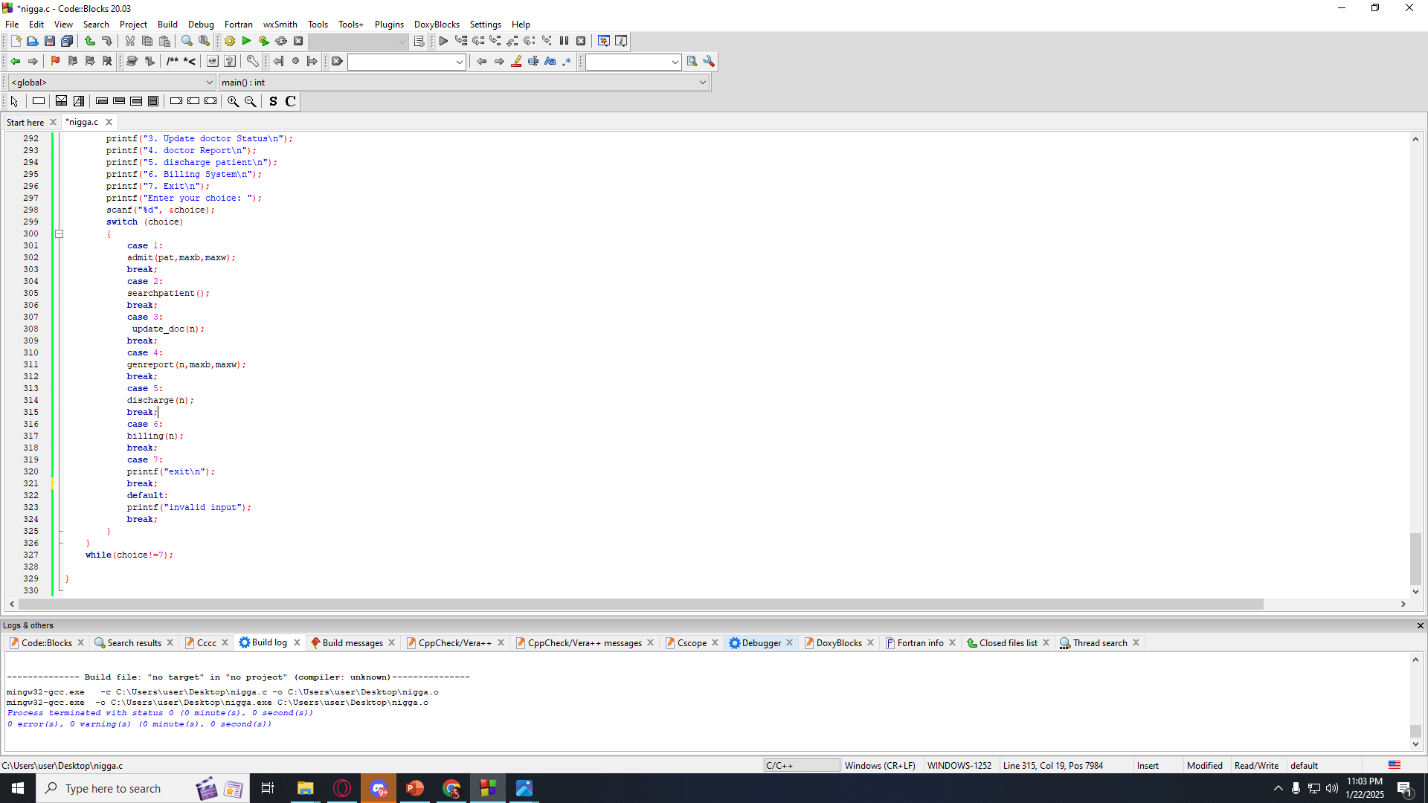
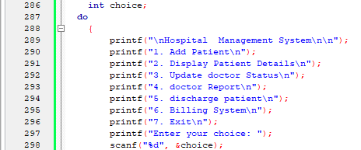
Main Function:
1.Function Definition:This line declares the main function.
2.Variable Declaration.
3.Taking input.
4.Calling Function.
Here we have printed our functionalities with do while loop
Here we used switch case to call the functions

Slide 11
THANK YOU!!!

